Slide 1
Judy Rosovsky
State Plant Regulatory Official (SPRO)
State Entomologist
Vermont Agency of Agriculture, Food and Markets

Slide 2
What are we looking for?
A regional update and overview of potential incoming pests and diseases

Slide 3
USDA APHIS PPQ
Each State:
State Plant Regulatory Official (SDA)
State Survey Coordinator (SDA)
State Plant Health Director (USDA)

Slide 4
Information from:
Surveys
Biosecurity
Emergency Management
Border Interdiction
Emergency Action Notifications
Pest Risk Assessment Committee; New Pest Advisory Group
USDA APHIS PPQ; DHS-CBP; State Depts of Ag-NASDA
Neighboring states/provinces
Other (CABI, NISIC, NPDN, NAPPO, NPB-EPB, CAPS, PPA)
Notes:
Proximity, climate are factors too. CABI is Center for BioScience International; NISIC is National Invasive Species Information Center; NPDN is National Pest Detection Network; NAPPO is North American Plant Protection Organization; CAPS is Cooperative Agricultural Pest Survey.

Slide 5
 | 85-88 | 97-00
Cerambycids | 211 | 686
Scolytinae | 2215 | 687
China | 15 | 357
Notes:
Scolytinae interceptions decreased with 1996 no bark rule; Cerambycids increased 1997-2000 due to increase in Chinese imports. It’s not the volume, it’s the impact. WPM 50% commerce only 2% inspected; almost all live plants inspected.

Slide 6
USDA APHIS plant pest programs: insects and mites
Surveyed for in VT:
Asian Longhorned Beetle
Cotton Pests
Drosophila suzukii (Spotted Wing Drosophila)
Emerald Ash Borer
European Grapevine Moth
Fruit Flies
Grasshopper/ Mormon Cricket
Gypsy Moth
Imported Fire Ant
Japanese Beetle
Khapra Beetle
Light Brown Apple Moth
Old World bollworm
Pine Shoot Beetle
Palm Weevils
Spotted Lanternfly
Y
N
N
In VT
Y
Y
N
In VT
N
In VT
Y-CBP
Y
N
In VT
N
Y
Notes:
If not said, remark on proximity and climate

Slide 7
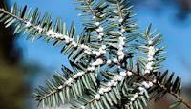
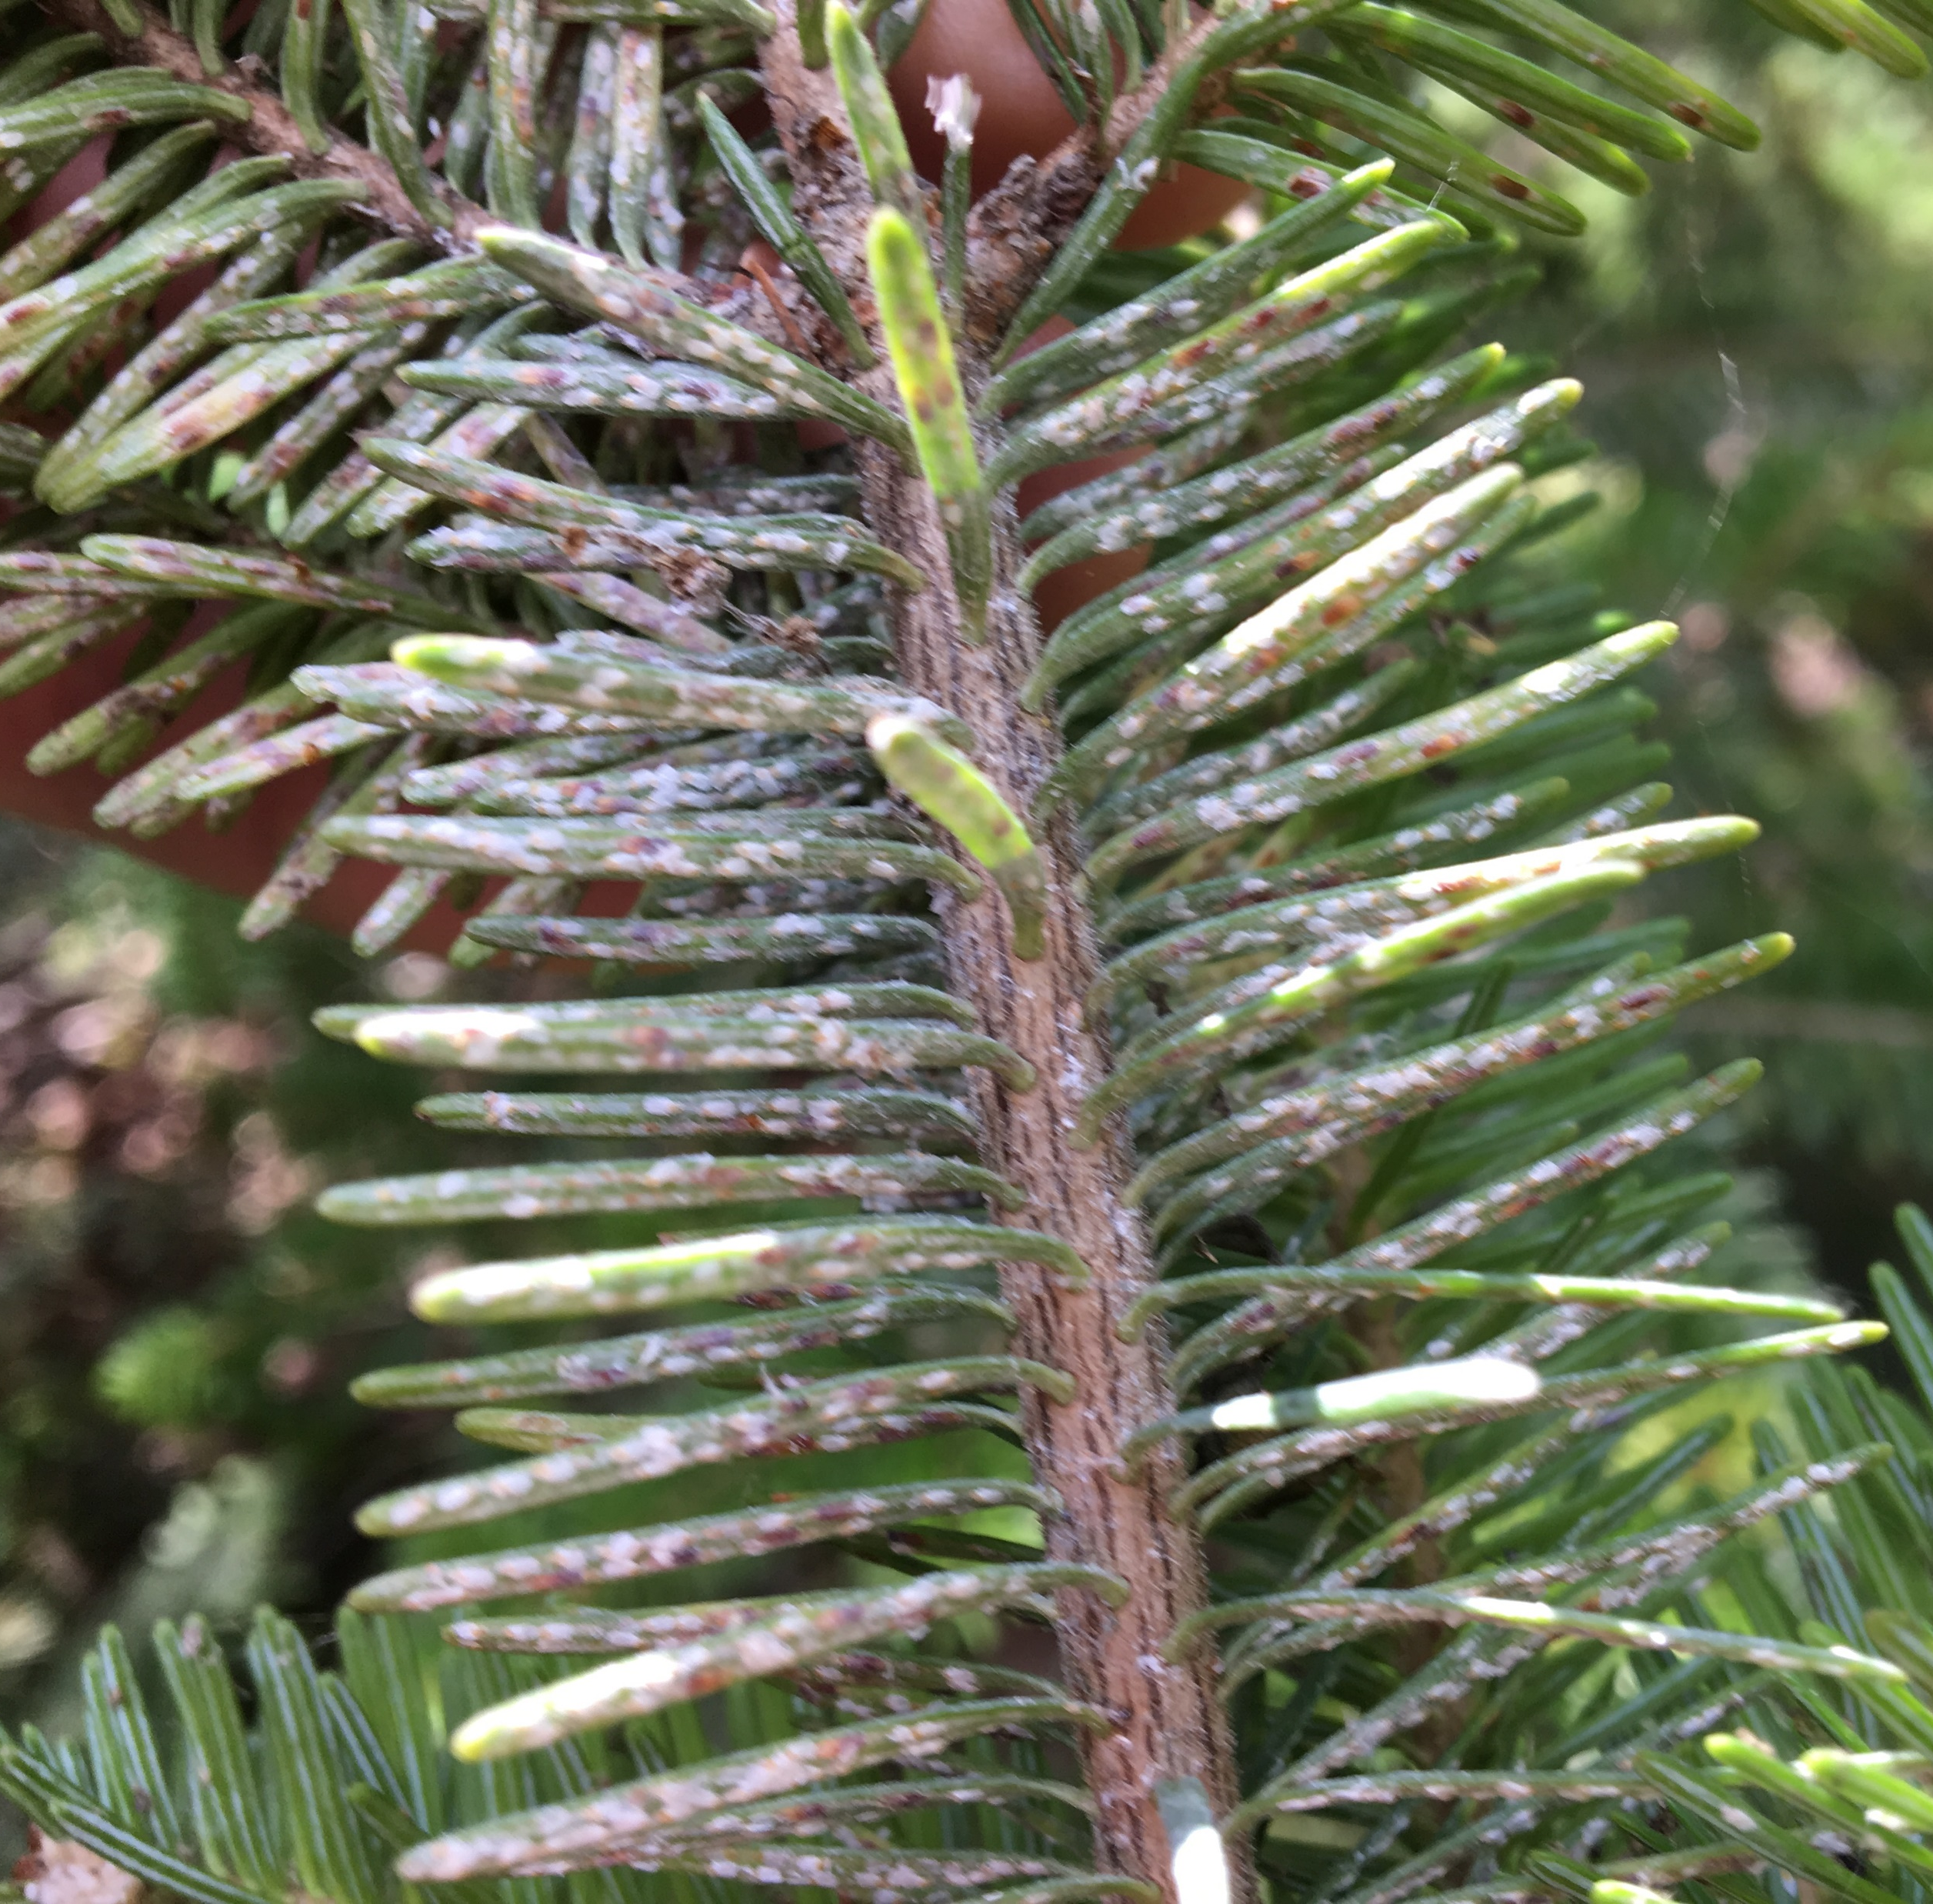
Existing VT problems – not Federally regulated
HWA
Hemlock woolly adelgid
Elongate hemlock scale
European fire ant
Swede midge
Leek moth
Brown marmorated stink bug
EHS
Notes:
HWA and EHS limited in VT by cold intolerance, so far.

Slide 8
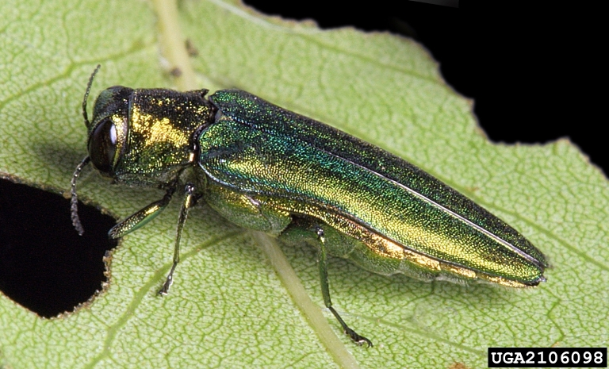
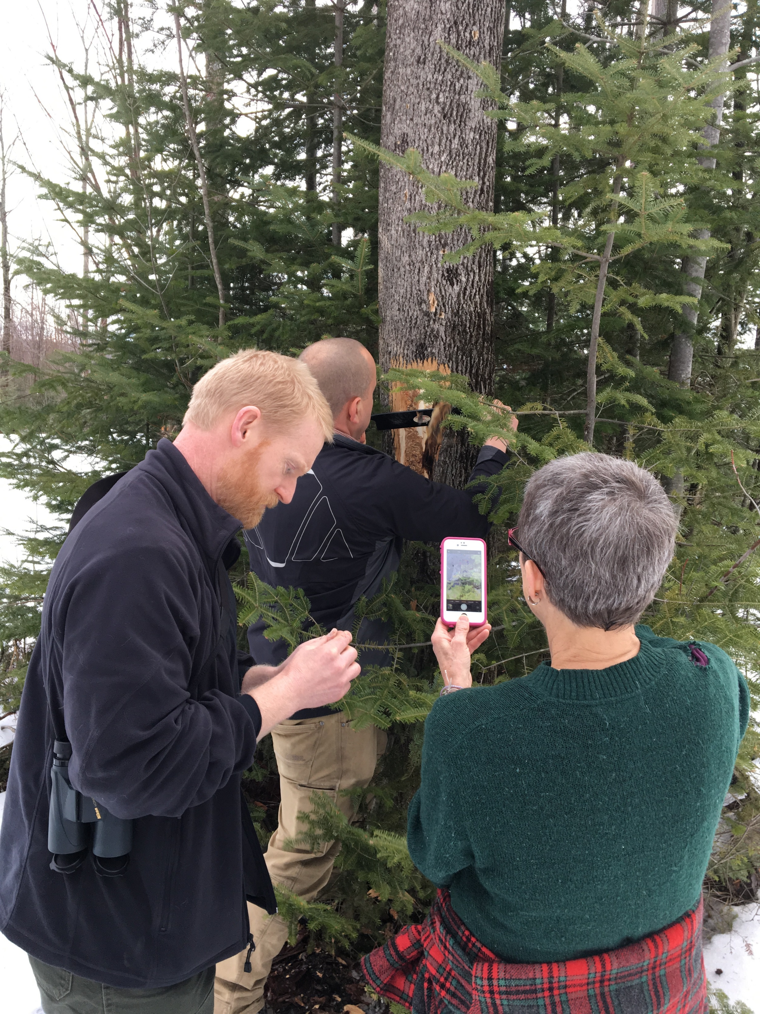
Emerald ash borer
VT First EAB Find 2018:
Tony Slowik, USDA PPQ; Nate Siegert, USDA FS; Barbara Schultz, VT ANR – FPR; not pictured Meredith Whitney, UVM Extension; Judy Rosovsky, VAAFM
In VT – ltd area
Kills ash
Ash are fragile when dead (https://www.farmprogress.com/land-management/dead-ash-trees-are-killing-people-don-t-be-negligent)
Biocontrol agents are available
Notes:
Dead ash are public health threat; small state needs to cooperate to maximize resources; formed FPAC

Slide 9
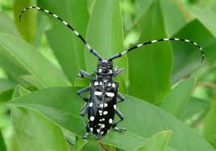
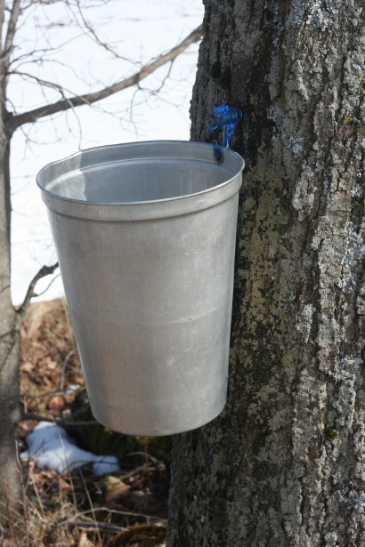
Asian longhorned beetle
‘a bucketload of trouble…’
In MA 10-15 yrs prior to detection
Primary host is maples
Has been eradicated IL, NY
Currently in OH
Notes:
Similar borers threats too; erad in urban areas, maybe wooded too? VT #1 maple producer in US. Come in on WPM

Slide 10
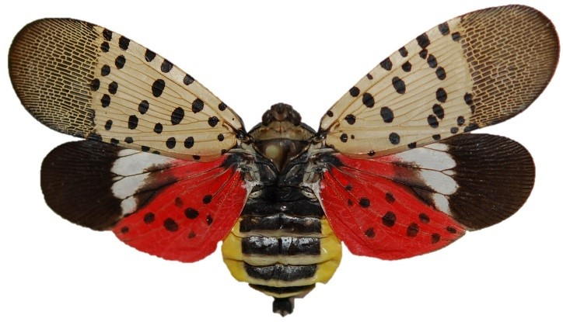
Spotted Lanternfly
Reproductive populations in
DE, MD, NJ, PA, WV
70 host species including grapes, hops, other agricultural crops.
COLD TOLERANT?
Ailanthus in VT?
Alternate reproductive hosts?
Notes:
A giant aphid. Exudes copious amounts of honeydew, which attracts sooty mold. Harms plants directly too. Like gypsy moth but worse. Possible alternate repro hosts are hops, chinaberry and black walnut

Slide 11
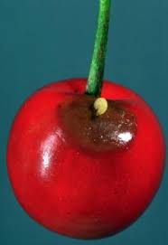
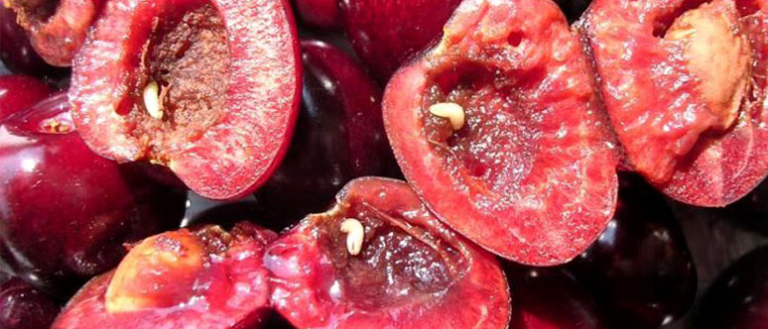
European Cherry Fruit Fly
Rhagoletis cerasi
USDA PPQ 2019 and 2020
VT Survey 150 traps
80-100% loss if not controlled
Transported by infested cherries, soil or fruit
ECFF larva damage to cherries. Credit: C. Daniel and J. Grunder NIH
Notes:
Canada is not pursuing eradication; NY is

Slide 12
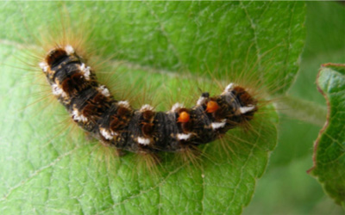
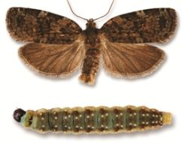
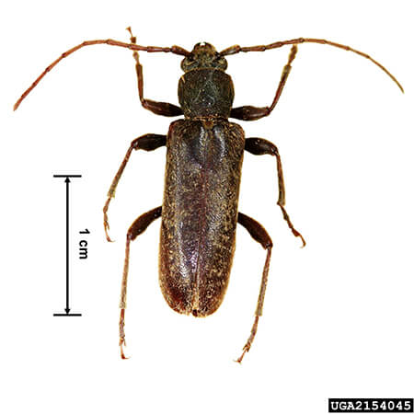
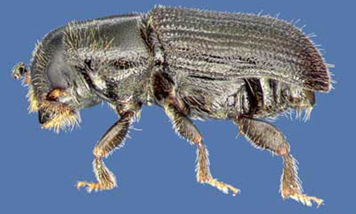
Potential incoming local pests:
Brown tailed moth – urticating hairs; present in ME
Spruce budworm – economic damage; infestation in Quebec
Velvet longhorned beetle - In IL, OH, MN, UT; apple, maple + 40 others
Southern pine beetle – found in MA
Notes:
SPB will infest and kill all species of pine within its distribution (Thatcher et al. 1980). In addition to southern species it attacks white pine and pitch pine.

Slide 13
Other nearby new or established pests
Brown spruce longhorned beetle – In New Brunswick and Novia Scotia – attacks red spruce
Kokeshi longicorn beetle – new in NJ
Agrilus sp. in NY beech
Xyleborus seriatus – new in VT
Palmer’s amaranth – in CT, can be toxic to livestock, outcompetes crops
Tomato Brown Rugose Fruit Virus –Fla and Can, spreads easily, overcomes plant genetic resistance

Slide 14
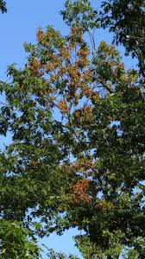
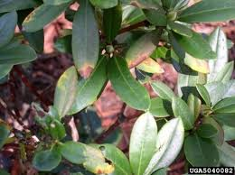
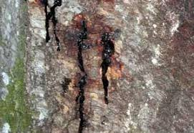
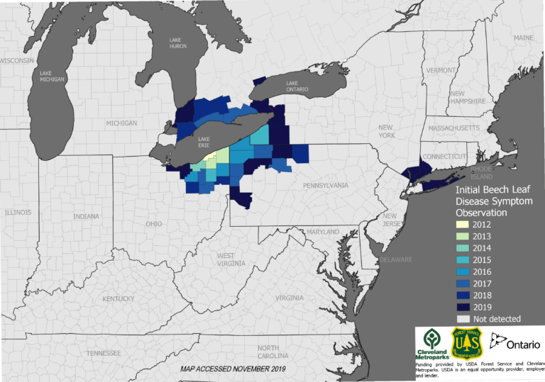
Diseases
SODS
Sudden oak death (Phytophthora ramorum) - moving on nursery stock; trace forward, not to VT
Boxwood blight (Calonectria pseudonaviculata) – trace forward
Chrysanthemum white rust (Puccinia horiana) –trace forward
Oak wilt – present in NY state
Beech leaf disease – NY and CT
BLD
Notes:
BLD first found in OH 2012.

Slide 15
Bottom line
Climate change will increase VT vulnerability to certain invasives
Sharing resources is KEY in a small state
Triage

